Slide 1

RATINGS PREDICTION
Submitted by:
NITI MARODIA

Slide 2

Business Problem Framing : We have a client who has a website where people write different reviews for technical products. Now they are adding a new feature to their website i.e. the reviewer will have to add stars (rating) as well with the review.

Slide 3
DATA COLLECTION: -Around 27 products have been scrapped for getting the data required for building the Machine Learning Model. We have scrapped from both Amazon and Flip-kart for the diversity in the data-set.

Slide 4
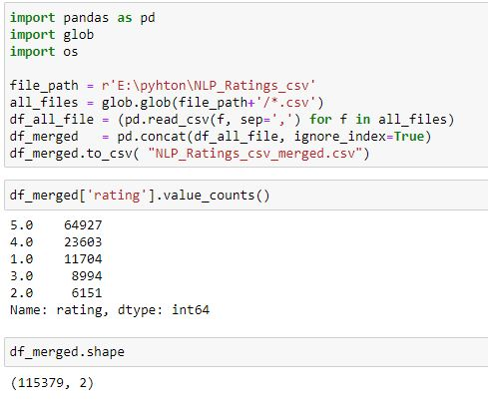
We could see that the data-set contains 115379 entries. Also, we can see that the data is imbalanced. Ratings counts differ for each rating.

Slide 5
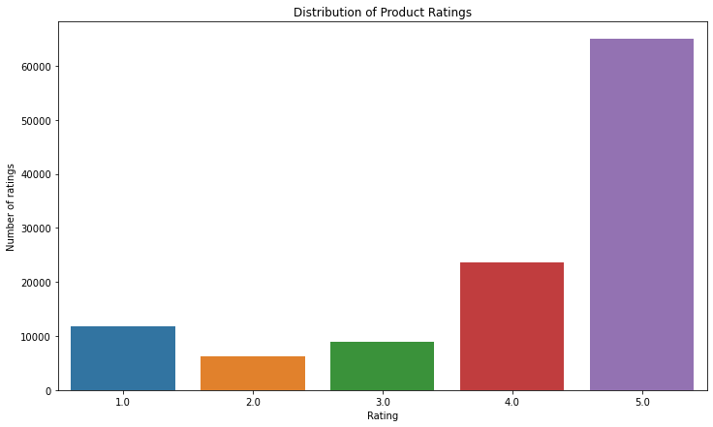

Slide 6
BALANCING THE DATA-SET & Data- Preprocessing:

Slide 7
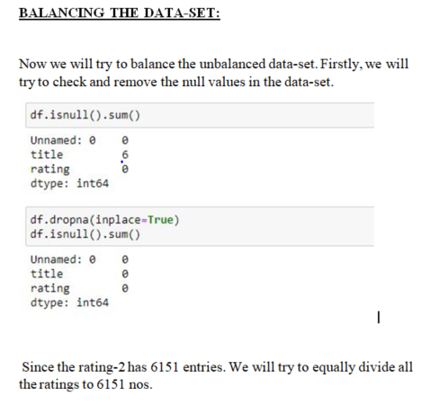

Slide 8
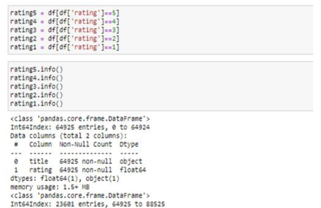

Slide 9
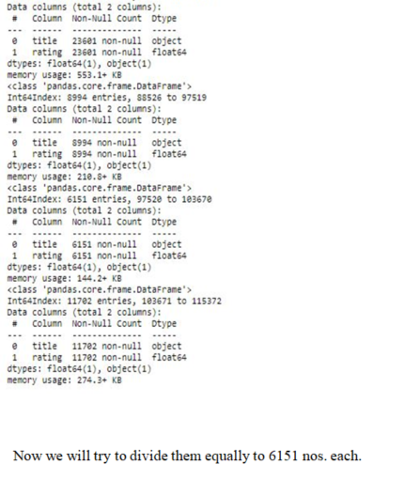

Slide 10
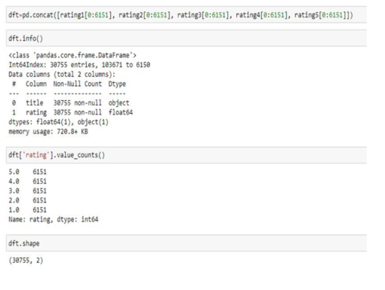

Slide 11
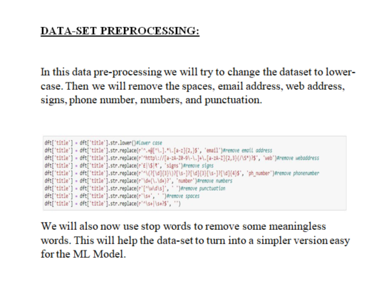

Slide 12
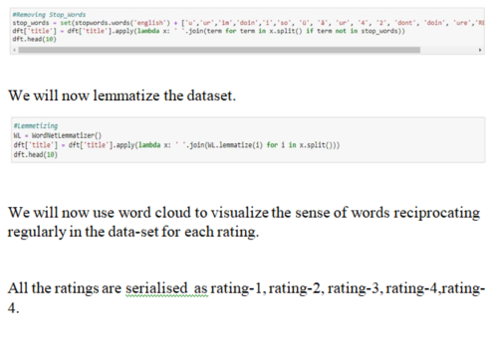

Slide 13
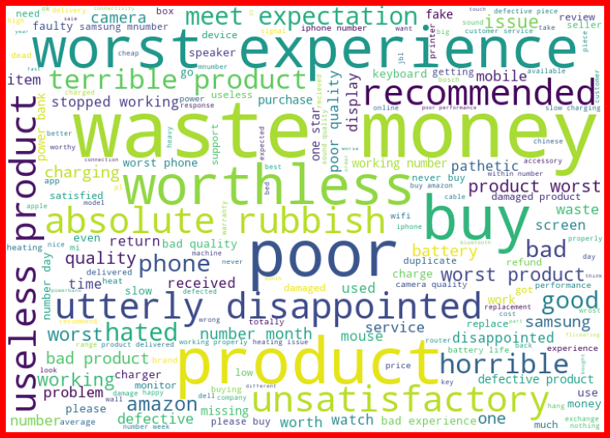
RATING - 1

Slide 14
RATING - 2

Slide 15
RATING - 3

Slide 16
RATING - 4

Slide 17
RATING - 5

Slide 18
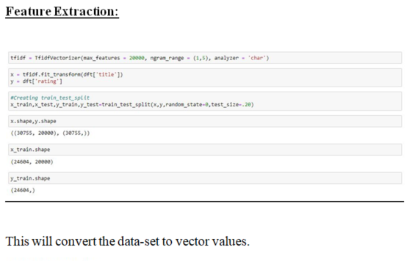

Slide 19
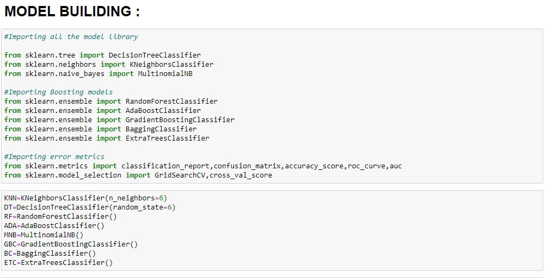

Slide 20
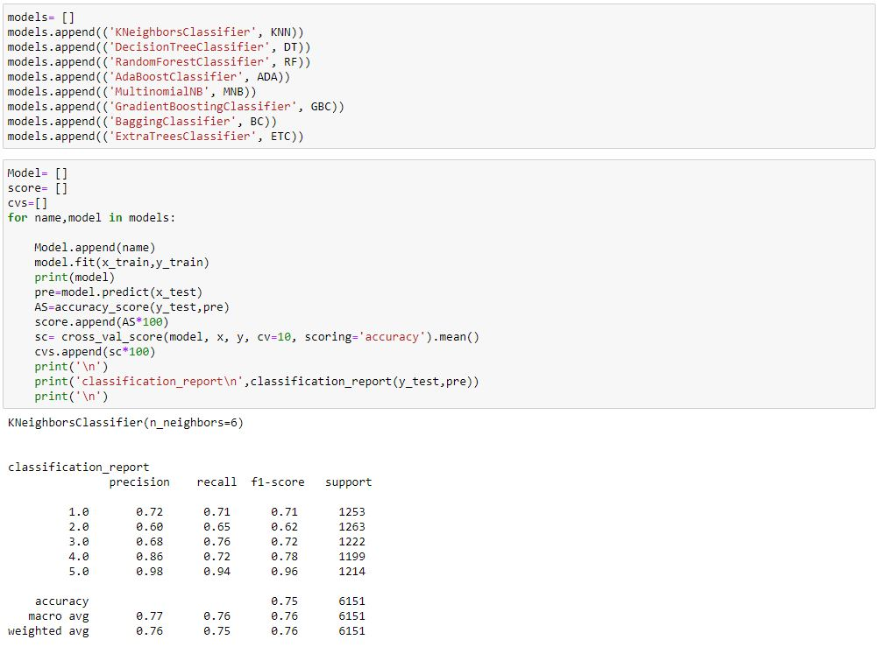

Slide 21
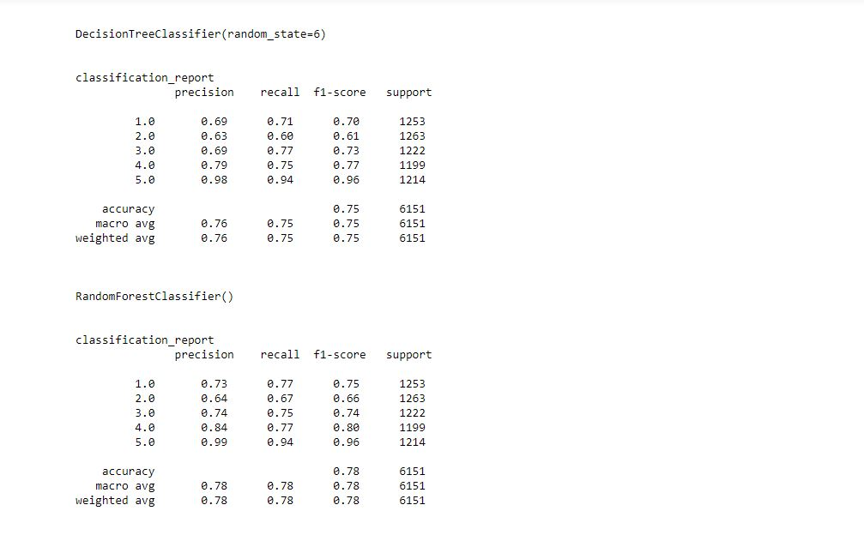

Slide 22
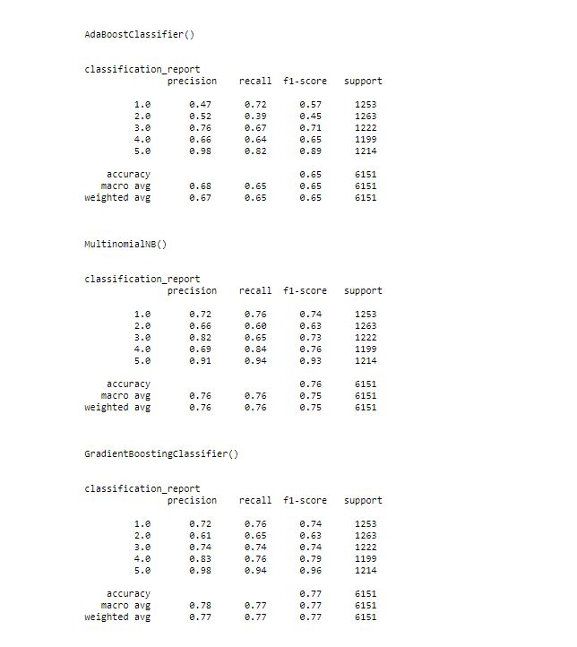

Slide 23
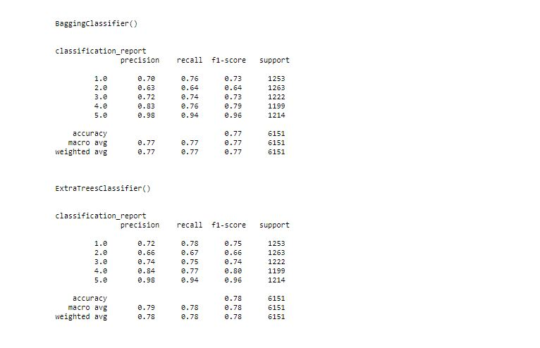

Slide 24
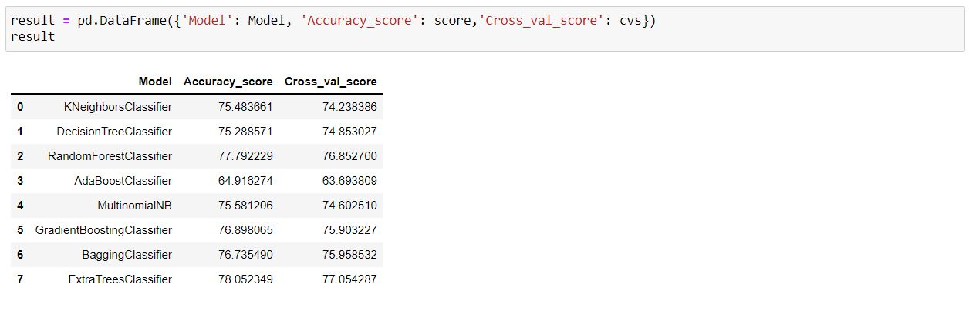

Slide 25
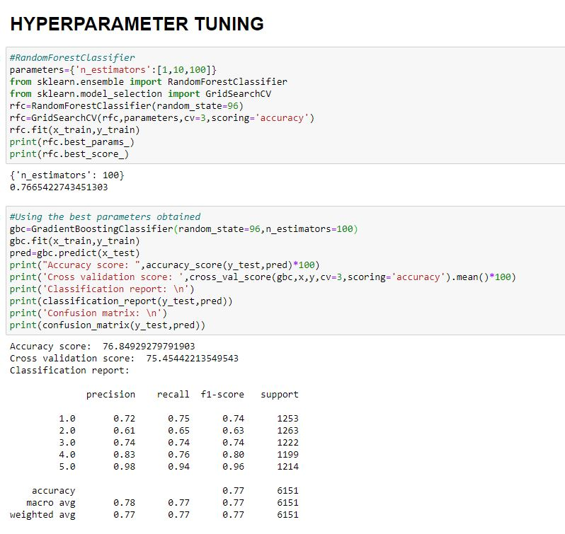

Slide 26
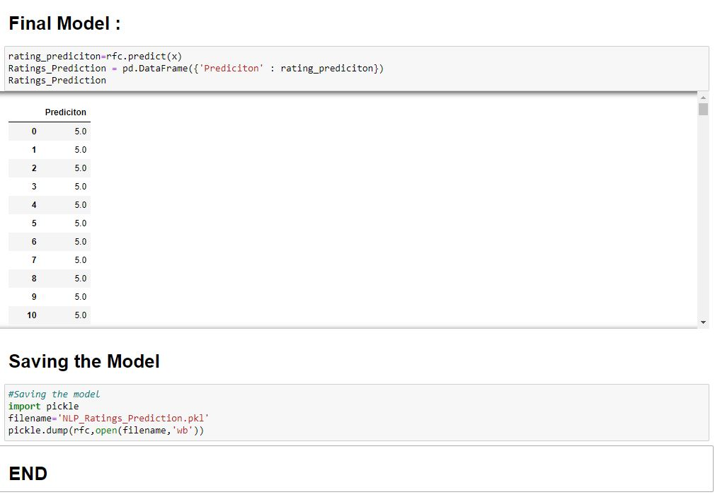

Slide 27
